Slide 1
Sustaining Your Efforts:
CONSIDERATIONS FOR TRAINING, COMMUNITY ENGAGEMENT, AND OUTREACH
TINA ATHERALL, DSW, LMSW
CEO, PSYCH/ARMOR

Slide 2
Key Topics
Education Strategies: Psych/Armor Suicide Prevention, Intervention, Postvention
Case Studies:
Collaboration
Assessing Statewide Training
Workforce Development Training
Employers (New Hampshire as the case example)
Healthcare provider training
Sustainability: Logic Models
Outputs
Evaluation

Slide 3
Suicide Prevention Courses:
“Barriers to Treatment”
“Crisis Response Plan for Healthcare Providers: Introduction & Assessment”
“Crisis Response Plan for Healthcare Providers: Intervention”
“How to Use the Crisis Response Plan: An introductory course”
“Posttraumatic Growth after Loss”
“Treating Grief in the Veteran Population”
“Unit Stabilization after Suicide Loss”
“What is the Crisis Response Plan: An introductory course for people who support Veterans”
“Postvention: Healing after Suicide”
“Finding Stability after Suicide Loss”
“Grief and Trauma”
“Columbia Scale for Communities”
“Columbia Scale for Military & Veterans”
“Columbia Scale for Caregivers and Spouses”
“Columbia Scale for Healthcare Provider”
Suicide Prevention, Intervention, and Postvention

Slide 4
SME Collaboration
Courses were built with advisement from advisory committee members from several sectors.
Kelly Posner, PhD. - The Columbia Lighthouse Project
Craig Bryan, PsyD - Stress, Trauma, & Resilience (STAR) Professor at The Ohio State University Wexner Medical Center
AnnaBelle Bryan, MA - Clinical Research Manager at The Ohio State University
Bonnie Carroll - Tragedy Assistance Program for Survivors
Kim Ruocco, MSW - Tragedy Assistance Program for Survivors
Shauna Springer, Ph.D.- Chief Psychologist, Stella Center
Keita Franklin, LCSW, PhD - Chief Clinical Officer, Loyal Source
Aimee Johnson, LCSW - Office of Mental Health and Suicide Prevention, Department of Veterans Affairs
CAPT Matthew Kleiman - Director of Psychological Health (Joint Surgeon's Office)
Suicide Prevention, Intervention, and Postvention

Slide 5
COLLABORATION:
Suicide Prevention, Intervention, and Postvention
PSYCHARMOR PROVIDES EDUCATION AND TRAINING NATIONALLY PsychArmor supports the SAMHSA / VA Challenges to Prevent Suicide Among Service Members Veterans, and their Families. The following cities and states have already started their learning:
MAYOR’S CHALLENGE
Lewis and Clark County, MT
Helena, MT
Billings, MT
Sparks, NV,
Reno NV
Las Vegas NV
Los Angeles, CA
Jacksonville, FL
GOVERNOR’S CHALLENGE
Colorado
Florida
Kansas
Montana
Nevada
New York
North Carolina
Pennsylvania
Tennessee
Texas
“By joining forces with PsychArmor Institute, Lewis and Clark Public Health trained more than 1,000 people ... The ultimate goal of this partnership is to prevent suicide in the military community by reducing problematic factors that might lead to suicidal thoughts - unemployment, financial difficulties, and lack of connection. Thanks to PsychArmor and the education it provides, we may be several steps closer to that goal.”
~ Jess Hegstrom, Health Educator,
Suicide Prevention

Slide 6
PROGRAM COLLABORATION: CASE STUDIES
Suicide Prevention, Intervention, and Postvention
OBJECTIVE ZERO was founded in 2016 to focus on the problem of suicide within the military community. Through the Objective Zero app, users can find a peer support Ambassador to connect with via text message.
Objective Zero needed to ensure that their peer support Ambassadors were trained and sufficiently prepared to respond to the concerns raised by app users.
SOLUTION Objective Zero partnered with Psych/Armor to train their Ambassadors. Over 425 learners have taken courses through the Psych/Armor Objective Zero learning team, completing over 1,000 courses.
"Psych/Armor Institute has been and continues to be instrumental in suicide prevention training and education for our 2,000+ volunteer Ambassadors. We simply would be unable to support the 10,000 users on the Objective Zero App without our partnership with Psych/Armor. Their various course offerings, from Operation SAVE to Columbia Scale training, prepare our Ambassadors to take texts, voice, and video chats from at-risk service members and veterans that need a listening ear."
~ Betsey Mercado, Co-Founder & Executive Director, Objective Zero

Slide 7
OBJECTIVE ZERO TEAM FEEDBACK
Suicide Prevention, Intervention, and Postvention
FROM 620 SURVEYS ...
97.4%
97.8%
99.5%
94.2%
of respondents reported learning something new as a result of this training.
of respondents reported the information presented was relevant to their goals.
of respondents reported after taking a course they will use what they learned.
of respondents reported they would recommend training to someone else.
IN-DEPTH ANALYSIS
A subset of these learners were invited to rate their knowledge, skills, and confidence on a 1 - 5 scale pre and post-learning.
Result: Learners consistently rated their knowledge, skills and confidence increased as a result of taking the courses

Slide 8
Assessing Regional to State-Wide Support: Fire Watch / Watch Stander Program

Slide 9
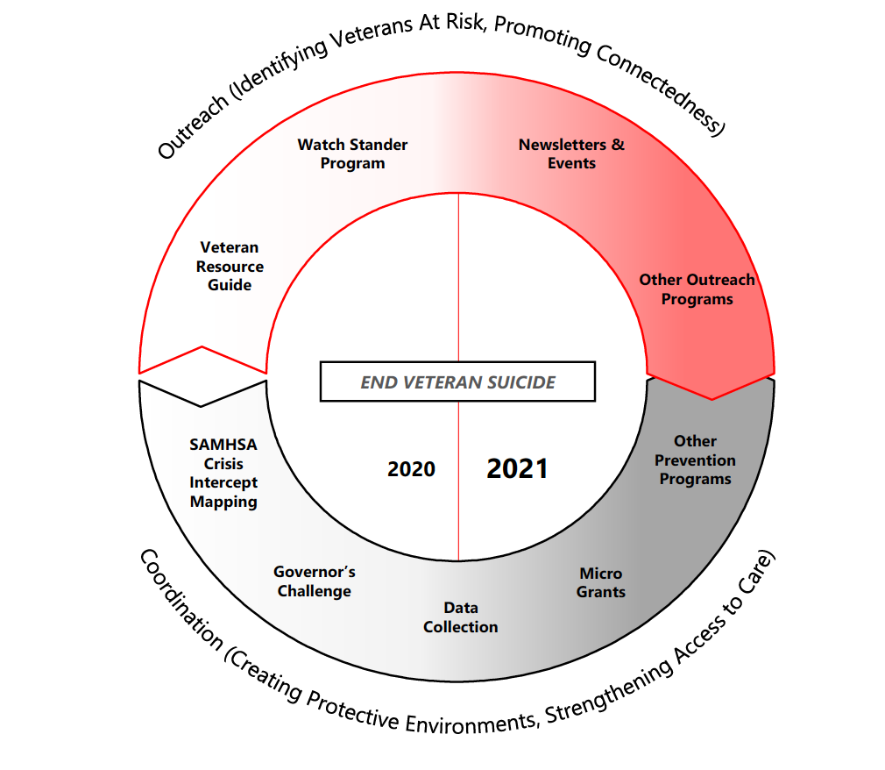
Assessing State-Wide Support: Fire Watch

Slide 10
Successful Sustain = Successful Implementation
The EPIS Framework
PsychArmor has adopted the Exploration, Preparation, Implementation, and Sustainment (EPIS)
framework as the basis for its implementation work.

Slide 11
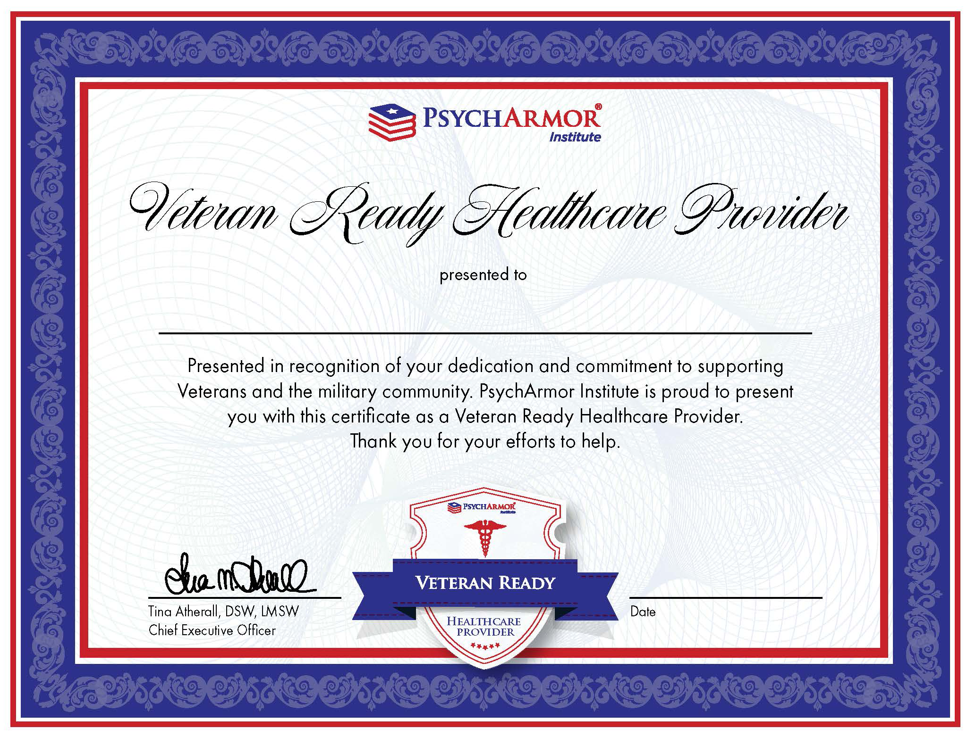
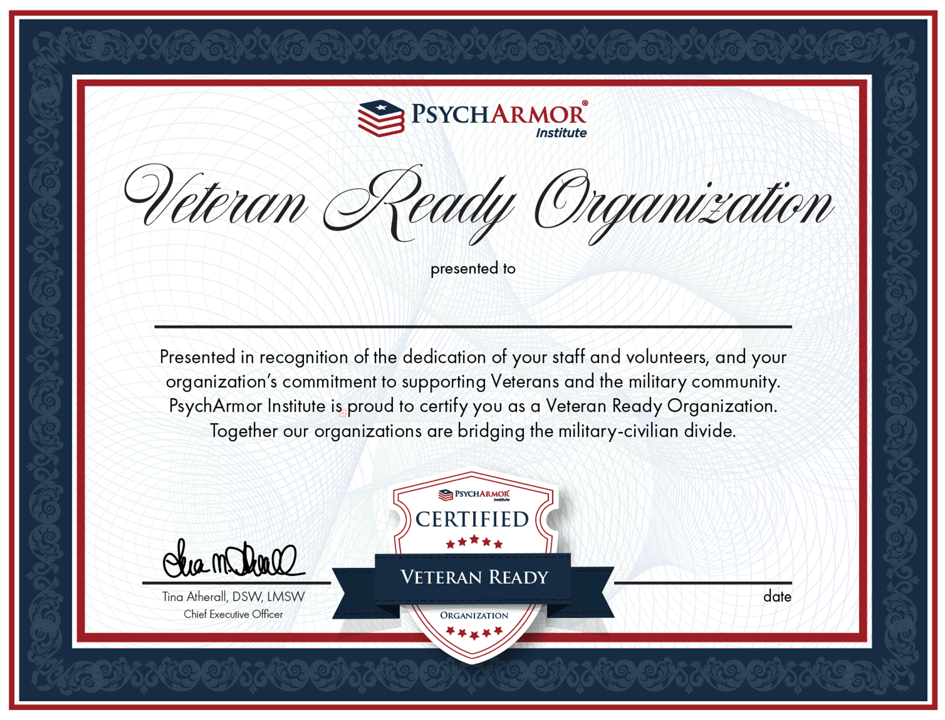
Successful Sustain = Successful Implementation
The EPIS Framework

Slide 12
PROGRAM COLLABORATION: CASE STUDIES
Suicide Prevention, Intervention, and Postvention
Total Facilities: 8
Total Learners: 292
Total Course Completions: 946
Summit Behavioral Healthcare (Summit BHC) was established to develop and operate a network of leading behavioral and mental health centers throughout the country. Summit BHC created their Tactical Recovery program specifically to serve Veterans.
Summit BHC wanted to ensure the staff and providers at their addiction and mental health centers are genuinely qualified to understand and treat Veterans.
SOLUTION By partnering with PsychArmor, Summit BHC educates their staff and providers to provide a culturally-competent and trauma-informed environment specifically tailored to promote recovery among Veterans.

Slide 13
Refreshing: Logic Models
REFRESHING: Logic Models
Inputs
Activities
Outputs
Outcomes
Impact
Implementation
Data Collection
Evaluation

Slide 14
Evaluation Model
Level 1
Reaction
Engagement
Relevance
Satisfaction
Drivers that support behavior change and results
Monitor & Adjust
Reinforce
Practice
Level 4
Results
Intermediate & Long-term Outcomes
Impact
Level 3
Behavior
Level 2
Learning
Knowledge
Skills
Attitude
Confidence
Coach
Encourage & Support
Kirkpatrick & Kirkpatrick, 2016

Slide 15
LEARNER FEEDBACK
Suicide Prevention, Intervention, and Postvention
Postvention: Healing After Suicide
“This course was very informative and professionally presented. Being a Peer Mentor for TAPS, I find it extremely helpful.”
Posttraumatic Growth After Loss
“Wonderful content. Gives hope to those just beginning their grief journey that things can change. Thank you.”
Columbia Scale for Military and Veterans
“Simple tool that addresses a tumultuous matter. I love that one of its goals is to increase confidence, because this can be the difference between life and death.”
Postvention: Healing After Suicide
“It was a wonderful video and helped me.”
Crisis Response Plan for Healthcare Providers: Intervention
“Thank you 🙂”
Posttraumatic Growth After Loss
“Great course, relevant information! Thank you!”
Columbia Scale for Communities
“Very detailed presentation. Well planned and informative.”

Slide 16
SUSTAINMENT: Education and Training Ecosystem
Coming Soon: Governor’s Challenge Education Ecosystem
Learning Community: Customized and exclusive learning community
accessible to the Governor’s Challenge Teams for training.
Goals:
Educate learners about military-connected culture, mental health, and suicide prevention.
Enhance community knowledge, equip learners with new skills, and increase learners confidence in using their new knowledge and skills.
Data Dashboards: Track utilization and effectiveness.
Training Evaluation: Allow state leadership to validate methods of delivery as effective means of training and intervention by conducting assessments and evaluating course impact on learners.
Supported Learning: Clinical Consultancy and Learner Support Center available to help learners implement the skills learned in courses.

Slide 17
THANK YOU
Tina Atherall, DSW, LMSW
Chief Executive Officer
tatherall@psycharmor.org
Carie Rodgers. PhD
Chief Program Officer
carie@psycharmor.org
www.psycharmor.org

